Slide 1
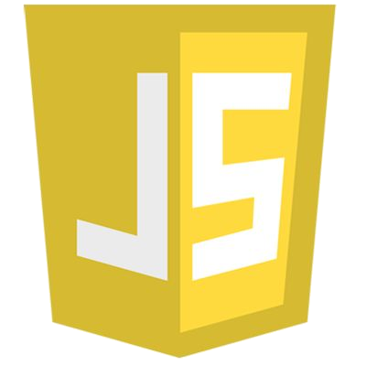
Prepared by: Muniba Javid
JavaScript Part 2

Slide 2
Installation
To work with JavaScript you don’t need any software
You just need to have Browser installed on your machine and you can use any text editor to write code.
To manage projects and organize ﬁles we use IDE
We will use Microsoft’s Visual Studio Code
To run JavaScript on server side we will use Node.js

Slide 3
Installation
Download and install Visual Studio code
https://code.visualstudio.com
Download install Node.js
https://nodejs.org/en/
Use default setting while installing both tools

Slide 4

Demo
How to use Visual Studio Code

Slide 5
Initial Code and Setup
Open Visual Studio code and create two ﬁles
index.html
Index.js

Slide 6
index.html ﬁle
<html>
<head>
<script src="./index.js"></script>
</head>
<body>
Hello World
</body>
</html>

Slide 7
index.js ﬁle
alert("Hello World");

Slide 8

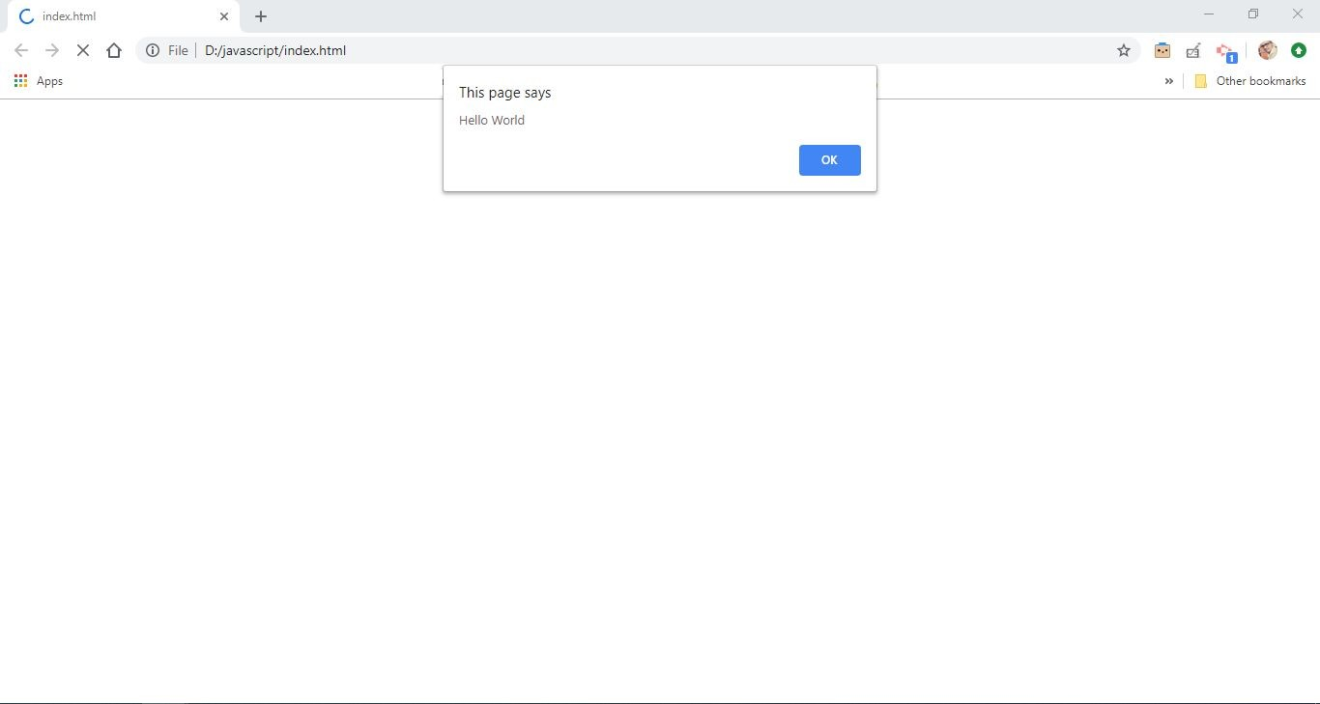
Initial Code and Setup
1. Open ﬁle in browser and you will see alert in browser window

Slide 9
Demo
Create First JavaScript Example

Slide 10

Demo
How to run JavaScript in Node.js

Slide 11
Alerts
An alert is a box that pops up to give the user a message.
Here's code for an alert that displays the message "Thanks for your input!"
alert("Hello World");
alert is a keyword
The quoted text "Thanks for your input!" is called a text string or simply a string.

Slide 12
Alerts
‘window.alert’ and ‘alert’ are the same
window is object in browser which contains many other objects and properties, and alert is one of them.
alert is a function that take any input and display it in popup to user
Alerts are not available when you are working with server side JavaScript in Node.js

Slide 13
Console.log
console.log is function that write message on console/terminal
Objective of console.log is to create logs for debugging
Instead of displaying text to user it shows output in browser’s developer tool
Also when working with server side javascript, we can use console.log for logging and output will be in terminal

Slide 14
Console.log
console.log("Hello World"); console.log(2+8);

Slide 15
document.write
1. For testing purpose you can use document.write to display message or text in browser window
document.write("Hello Word"); document.write(2+8);
This will be displayed in browser window

Slide 16
Variables

Slide 17
Variables
Variables are containers for storing data values.
Variables are used to store information to be referenced and manipulated in a computer program
Variable is a term that refers to a particular value
A variable changes over time or based on user input.
A variable is assigned a value in one place and then used repetitively.

Slide 18
Variables
Keyword to create variable
Value
var nationality = "Pakistani";
Variable name/identifier

Slide 19
Variables
var | nationality = "Pakistani";
var | age = 25;
var | isFeePaid = true;
var | weight = 60.55;

Slide 20
Declaration and Initialization
1. You can declare and initialize in single line or you can do that in two line
var | age | = | 25; | OR
var | age; |  | -- | Declaration
age | = 25; |  | -- | Initialization
Only declaration will leave variable undeﬁned

Slide 21
Data Types

Slide 22
Data Types
Variables contains data
Each data has type, that’s why we call it data type
Variables can hold numbers like 100 and text values like "John Doe"
In programming, text values are called text strings.

Slide 23
Data Types
Six types are considered to be primitives.
Number -- integers, ﬂoats etc
String -- an array of characters
Boolean -- true or false
Null -- No Value
Undeﬁned -- a declared variable but hasn’t been given a value
Symbol -- a unique value that's not equal to any other value

Slide 24
Data Types
Complex Types
Objects
Functions
Function is callable object that executes a block of code, it lies under the object type

Slide 25
Variable for String
1. To store text in variable we use string
var name = "Mark"; name = "John";

Slide 26
String - Single quotes and double quotes
Text strings are always enclosed in quotes
You can use single or double quotes
var name = "Mark";
var nationality = 'US';
var message = "What is your father's number";

Slide 27
Variable for Numbers
1. To store whole numbers or decimal values we use number data type
var age = 25;
var weight = 150.5;
var newWeight = weight + 20; var originalNumber = 12 + 5;

Slide 28
Variable for Boolean
1. To store true/false boolean data type
var isFeePaid = true; var examPassed = false;

Slide 29
Undeﬁned
The undeﬁned data type can only have one value-the special value undeﬁned
If a variable has been declared, but has not been assigned a value, has the value undeﬁned
var name; var age;

Slide 30
Undeﬁned
You can be empty a variable by setting the value to undeﬁned. The type will also be undeﬁned
var name = "Mark"; name = undefined;
Now this variable contains no value, and it will cause error if we try to apply some operation on it

Slide 31
Null
This is another special data type that can have only one value-the null value.
A null value means that there is no value.
It is not equivalent to an empty string ("") or 0, it is simply nothing
var name = null;
var nationality = "Mark"; nationality = null;

Slide 32
Difference between null and undeﬁned
undeﬁned means a variable has been declared but has not yet been assigned a value.
null is an assignment value. It can be assigned to a variable as a representation of no value
undeﬁned and null are two distinct types: undeﬁned is a type itself (undeﬁned) while null is an object.
Unassigned variables are initialized by JavaScript with a default value of undeﬁned. JavaScript never sets a value to null. That must be done programmatically.

Slide 33
JavaScript Data Types are Dynamic
JavaScript has dynamic types. This means that the same variable can be used to hold different data types
You can assign any type of value in variable any time and data type of variable will be changed
var name = "Mark"; / It’s String
name = 25; / Now changed to Number
name = true; / Now changed to Boolean

Slide 34
typeof Operator
You can use the JavaScript typeof operator to ﬁnd the type of a JavaScript variable.
The typeof operator returns the type of a variable or an expression
typeof "Hello" // Returns "string" var a = 45;
typeof | a; | // | Returns | "number"
typeof | true; | // | Returns | "boolean"

Slide 35
Statement and Expression

Slide 36
Statements
A computer program is a list of "instructions" to be "executed" by a computer.
In a programming language, these programming instructions are called statements.
A JavaScript program is a list of programming statements.
A statement can set a variable equal to a value.
A statement can also be a function call, i.e. document.write().

Slide 37
Statements
Statements deﬁne what the script will do and how it will be done.
Most JavaScript programs contain many JavaScript statements.
The statements are executed, one by one, in the same order as they are written.

Slide 38
Statements
1. Each line below is a statement
var | a | = | 4; | // | Statement | 1
var | b | = | 2; | // | Statement | 2
var | c | = | 0; | // | Statement | 3
c = | a | + | b; | // | Statement | 4
alert(a); |  |  |  | // | Statement | 4
console.log(c); |  |  |  | // | Statement | 4

Slide 39
End of Statement with semicolon ;
To end statement add semicolon at the end of each executable statement
Semicolons separate JavaScript statements.
var a = 4;
When separated by semicolons, multiple statements on one line are allowed
i = 3; j = 5; k = i + j; alert(i);console.log(k);

Slide 40
End of Statement without semicolon ;
Typically we end statements with semicolon but JavaScript semicolon is optional, but is highly recommended to end with semicolon
The end of a statement is most often marked by pressing enter and starting a new line.

Slide 41
End of Statement without semicolon ;
var a = 5 a * 4 alert(a)
console.log(a)
// New line will end statement
var a = 5a * 4 alert(a)console.log(a)
// Error, Will Not work
// Error, Will not work

Slide 42
Expressions
An expression is a combination of values, variables, function calls and operators, which computes to a value.
The computation is called an evaluation.
a 4 | + / | b; 2; | // // |  | expression expression
var |  | a | = | 5;
a * 4;
"John" + " " + "Doe";
// expression
// expression

Slide 43
Comments

Slide 44
Comments
Comments are for the human, not the machine.
They help you and others understand your code when it comes time to revise, they make code more readable.
You can also use commenting to comment out portions of your code for testing and debugging.
They will prevent execution of code
There are two ways mark text as a comment, single line comments and multi-line comments

Slide 45
Single line comments
Single line comments start with //.
Any text between / and the end of the line will be ignored (will not be executed).
// Declare and initialize variable var a = 6; //This is comment
//This below code will not execute
//var b = 8;

Slide 46
Multi-line comments
Multi-line comments start with /* and end with */.
Any text between /* and */ will be ignored.
/*
This code declared and initialize variable a and show on screen
*/
var a = 6; alert(a);

Slide 47
Variable Names

Slide 48
Variable Names Legal and Illegal
A variable name can't contain any spaces
A variable name can contain only letters, numbers, dollar signs, and underscores.
The ﬁrst character must be a letter, or an underscore (_), or a dollar sign ($).
Subsequent characters may be letters, digits, underscores, or dollar signs.
Numbers are not allowed as the ﬁrst character of variable.

Slide 49
Variable Names Legal and Illegal
1. Legal names:
var | hello = | 56;
var | _xyz = | 44;
var | $work = | 90;
var | user2 = | 56;
var | i_info | = 99;
var | my$work | = 77;

Slide 50
Variable Names Legal and Illegal
1. Illegal names:
var 2user = 12; // Can't start with number var my user = 23; // Can't contains space var hello#world = 34;
var my-info = 44; var my?info = 45; var my*info = 45;

Slide 51
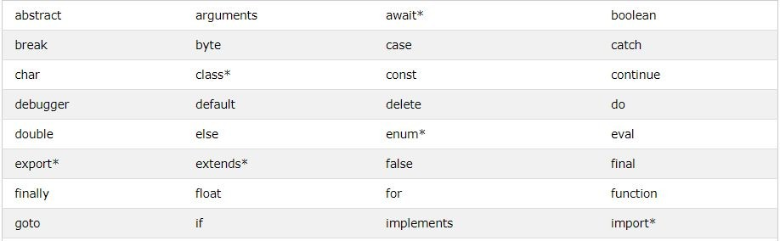
Reserved Keywords
Reserved Keywords cannot be used as variable name
Here are few reserved keywords

Slide 52
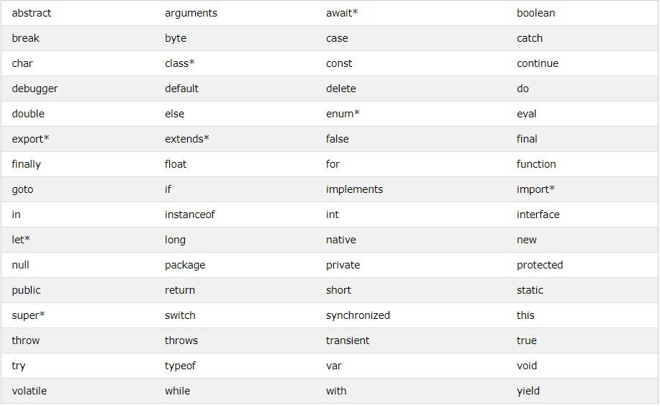

Slide 53
Case Sensitive
Variable names are case sensitive.
So rose and Rose are two different variables
var | rose | = | "Hello";
var | Rose | = | "Hello";
alert(rose); alert(Rose); alert(ROSE); // Error

Slide 54
Camel Case
If there's more than one word in the variable name, then it is recommended to use camel case
A camelCase name begins in lower case. If there's more than one word in the name, each subsequent word gets an initial cap, creating a hump.

Slide 55
Camel Case
var userResponse
var userResponseTime
var userResponseTimeLimit var response
This Style of naming a variable is called camel case

Slide 56
Operators

Slide 57
Arithmetic Operators
var | a | = | 5;
var | b | = | 3;
var | c | = | a | + | b; | // | Addition, | result | 8
var d = a - b; var e = a * b; var f = a / b; var g = a % b; var h = a ** b;
// Subtraction, result 2
// Multiplication, result 15
// Division, result 1.66
// Modulus, result 2
// Exponentiation, result 125

Slide 58
Assignment Operators
Assignment operator assign value to variables
When you need to apply arithmetic operation and assign value to same variable then you can also use them
var a = | a a | = + | 5; 2; | // // | equals Assign | = 7 | is in | assignment operator variable a
OR
var | a | = | 5;
a+=2; |  | // |  |  | Assign | 7 | in | variable | a

Slide 59
Assignment Operators
Example
Same as
a | += | 5; | a | = | a | + | 5;
a | -= | 5; | a | = | a | - | 5;
a | *= | 5; | a | = | a | * | 5;
a | /= | 5; | a | = | a | / | 5;
a | %= | 5; | a | = | a | % | 5;
a | **= | 5; | a | = | a | ** | 5;

Slide 60
Eliminating ambiguity -- BODMAS
Complex arithmetic expressions can pose a problem when there are multiple operators in single expression
var a = 5 + 2 * 3 - 2 / 2; // result 10
The evaluation of above expression is depends on BODMAS rule
3.

Slide 61
Eliminating ambiguity -- BODMAS
B
O DM AS
Brackets ﬁrst
Orders (i.e. Powers and Square Roots, etc.) Division and Multiplication (left-to-right) Addition and Subtraction (left-to-right)

Slide 62
Eliminating ambiguity -- BODMAS
var a = 5 + 2 * (3 - 2) / 2; // result 6
3 - 2 with brackets will be evaluated ﬁrst, result 1
2 * result of (3 - 2) so 2 * 1, result 2
Result of 2 * (3 -2) divide by 2 so 2 / 2, result 1 4. 5 + result of 2 * (3 - 2 ) / 2, so 5 + 1, result 6

Slide 63
Eliminating ambiguity -- BODMAS
var | a | = | 3 | + | 5 | * 2; |  |  |  |  | // | result | 13
var | b | = | 8 | / | 2 | - 1; |  |  |  |  | // | result | 3
var | c | = | 3 | % | 2 | + 4 | - 1; |  |  |  | // | result | 4
var | d | = | a | + | 5 | * c | - b | / | (3 | + | b);// | result | 32.5

Slide 64
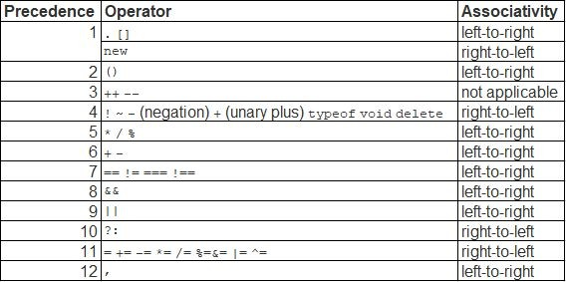
Operator Precedence -- Few of them

Slide 65
Increment and Decrement Operator
While working on application you will frequently required to increase variable by 1 or decrease variable by 1
For this situation you can use increment and decrement operator
3. ++ increment operator
-- decrement operator
These operators can be used as preﬁx and postﬁx

Slide 66
Increment and Decrement Operator
1. We can increase or decrease value using existing addition and subtraction operators
var | a | = | 12;
a = | a | + | 1; | // | 13
a = | a | - | 1; | // | 12
var | b | = | 12;
b += |  | 1; |  | // | 13
b -= |  | 1; |  | // | 13

Slide 67
Increment and Decrement Operator
Preﬁx Increment and Decrement
var age = 12;
++age; alert(age); | //Result | 13
--age;
alert(age); | //Result | 12

Slide 68
Increment and Decrement Operator
Postﬁx Increment and Decrement
var age = 12;
age++; alert(age); | //Result | 13, | same | as | prefix
age--;
alert(age); | //Result | 12, | same | as | postfix

Slide 69
Increment and Decrement Operator
What is the difference between Preﬁx and Postﬁx
You will NOT ﬁnd any difference if you will not assign result of preﬁx and postﬁx to any other variable
Preﬁx operator ﬁrst increase/decrease the value in variable and then assign result to other variable
Postﬁx operator ﬁrst assign the value in other value then increase/decrease value in actual variable

Slide 70
Increment and Decrement Operator
Preﬁx Increment
var age = 12;
var newAge = ++age;
alert(age); | //Result | 13
alert(newAge); | //Result | 13

Slide 71
Increment and Decrement Operator
Postﬁx Increment
var age = 12;
var newAge = age++;
alert(age); alert(newAge);
//Result 13
//Result 12 , see the difference

Slide 72
Increment and Decrement Operator
Preﬁx Decrement
var age = 12;
var newAge = --age;
alert(age); | //Result | 11
alert(newAge); | //Result | 11

Slide 73
Increment and Decrement Operator
Postﬁx Decrement
var age = 12;
var newAge = age--;
alert(age); alert(newAge);
//Result 11
//Result 12 , see the difference

Slide 74
Increment and Decrement Operator
Example 1
var var | a b | = = | 4; 2;
var | c | = | a++ - b; | // first value | of a placed | here
which is 4 then increase 1 in a so will become 5
alert(a); | // | 5
alert(b); | // | 2
alert(c); | // | 2

Slide 75
Increment and Decrement Operator
Example 2
var var | a b | = = | 4; 2;
var | c | = | ++a | + b; | // first value | of a increased | so
will become 5 then value of a will be placed here, 5
alert(a); | // | 5
alert(b); | // | 2
alert(c); | // | 7

Slide 76
Increment and Decrement Operator
Example 3
var | a | = | 4;
var | b | = | 3;
var | c | = | a++ | + | --b | - --a;
alert(a);
alert(b);
alert(c);

Slide 77
Increment and Decrement Operator
Example 4
var | a | = | 4;
var | b | = | 3;
var | c | = | ++a | + | b++ | - a | + | --b;
alert(a); |  |  |  | // |  | 5
alert(b); |  |  |  | // |  | 3
alert(c); |  |  |  | // |  | 6

Slide 78
String Concatenation

Slide 79
Concatenating Text strings
The + operator can also be used for concatenating strings
E.g:
var firstName = "Abraham"; var lastName = "aLincoln";
//concatenate firstName, space character and lastName var fullName = firstName + " " + lastName; alert(fullName);

Slide 80
Concatenating strings and numbers
1. Adding two numbers, will return the sum, but adding a number and a string will return a string:
var | a | = | "6" | + 2; | // |  | "62"
var | b | = | 3 + | "6"; | // |  | "36"
var | c | = | "Hello " + |  | 2; | // | "Hello 2"
var | d | = | 2 + "Hello |  | "; | // | "2 Hello"
var e = "Hello "+ 3 + 4; var f = 3 + 4 + "Hello "; var g = "Hello "+ (3 + 4);
// "Hello 34"
// "7Hello"
// "Hello 7"

Slide 81
Prompt and Parsing String

Slide 82
prompt or window.prompt()
The prompt()/window.prompt() method displays a dialog box that prompts the visitor for input.
In a prompt, you can specify a second string. This is the default response that appears in the ﬁeld when the prompt displays.
The prompt() method returns the input value if the user clicks "OK". If the user clicks "cancel" the method returns null.

Slide 83
prompt or window.prompt()
var question = "What is your name?"; var defaultAnswer = "John";
var name = prompt(question, defaultAnswer); console.log("Name = "+ name);

Slide 84
prompt or window.prompt()
1. If you ask for number in prompt and try apply addition operator on it then it will concatenate the value because prompt returns string
var question = "What is your age?";
var age = prompt(question);// Assuming input 12 var newAge = age + 5; // It will concatenate console.log("New Age = "+ newAge); //result 125

Slide 85
Convert string to integer
1. Addition operator in string concatenate values, even if value in string is number
var | value1 | = | "3";
var | value2 | = | "5";
var | value3 | = | value1+value2;
console.log(value3);// result, 35

Slide 86
Convert string to integer
1. prompt function also returns string even if you provide number in input box
//Assuming we will provide value 5 in input
var | age | = | prompt("What | is | your | age");
var | num | = | 4;
var | sum | = | age + num;
console.log(sum); // result, 54

Slide 87
Convert string to integer
If you are sure that string has number, then you have to convert it into number to perform addition
We need to use parseInt function for conversion
var | age | = | prompt("What | is | your | age");//input | 5
var | num | = | 4;
var | sum | = | parseInt(age) | + | num;
console.log(sum); // result, 9

Slide 88
Convert string to integer
1. If value is not number then it will return NaN
var | age | = | prompt("What | is | your | age");//input | abc
var | num | = | 4;
var | sum | = | parseInt(age) | + | num;
console.log(sum); // result, NaN

Slide 89
Convert string to decimal
1. If your string is number with decimal places then you can use parseFloat for conversion
var | age | = | prompt("What | is | your |  | age");//input | 5.5
var | num | = | 4;
var | sum | = | parseFloat(age) |  | + | num;
console.log(sum); // result, 9.5

Slide 90
Convert string to Number
The Number() function converts the object argument to a number that represents the object's value.
If the value cannot be converted to a legal number, NaN is returned.
var | age | = | prompt("What is your | age");//input 5.5
var | num | = | 4;
var | sum | = | age + Number(num);
console.log(sum); // result, 9.5

Slide 91
Convert string to Number
1. In case of Number() function you don’t have to use separate parseInt or parseFloat function for conversion
var | a | = | Number(true); | //returns | 1
var | b | = | Number(false); | //returns | 0
var | c | = | Number("999"); | //returns | 999
var | d | = | Number("999 888"); | //returns | NAN
var | e | = | Number("Hello"); | //returns | NAN

Slide 92
Comparison Operators

Slide 93
Comparison operators
1. Comparison operators are used in logical statements to determine equality or difference between variables or values. They will result in true or false only
Operator | Description
== | equal to
=== | equal value and equal type
!= | not equal
!== | not equal value or not equal type
Operator | Description
> | greater than
< | less than
>= | greater than and equal to
<= | less than and equal to

Slide 94
Comparison operators
var a = 3;
console.log(a | == 6); | //return | false
console.log(a | === 6); | //return | false
console.log(a | != 6); | //return | true
console.log(a | !== 6); | //return | true
console.log(a | > 6); | //return | false
console.log(a | < 6); | //return | true
console.log(a | >= 6); | //return | false
console.log(a | <= 6); | //return | true

Slide 95
Comparison operators
1. == and === are used for equality check
2. == does not consider data type of values being compared and
3. == tries to convert one of the value and compare based on that
4. === also check datatype of the values and datatype of value on both side should be same otherwise it will return false

Slide 96
Comparison operators
var a = 3; console.log(a | == | 3); | //return | true
console.log(a | == | "3"); | //return | true
console.log(a | == | 6); | //return | false
console.log(a | === | 3); | //return | true
console.log(a | === | "3"); | //return | false
console.log(a | === | 6); | //return | false

Slide 97
Comparison operators
Be careful JavaScript is dynamic language and many decision taken at start are still causing confusion
Comparing different type of values will result in answer which is not easily understandable
E.g: When comparing a string with a number, JavaScript will convert the string to a number while doing the comparison. An empty string converts to 0. A non-numeric string converts to NaN which is always false.

Slide 98
Logical Operators

Slide 99
Short-circuit Logical Operators
Logical operators are used to determine the logic between variables or values.
Logical operators required boolean operands on both side of operator
However, the && and || operators actually return the value of one of the speciﬁed operands, so if these operators are used with non-Boolean values, they will return a
non-Boolean value.

Slide 100
Logical Operators
There are three logical operators in JavaScript:
|| (OR)
&& (AND)
! (NOT)

Slide 101
&& Logical Operator
1. This logical operator is used with two or more values (operands), and only evaluates to true if all the operands are true. It will return the false value if at least one value is false.
alert( | true | && | true ); | // | true
alert( | false | && | true ); | // | false
alert( | true | && | false ); | // | false
alert( | false | && | false ); | // | false

Slide 102
&& Logical Operator
var a = 60;
var b = a > 50 && a < 70; alert(b); // return true
var c = 80;
var d = c > 50 && c < 70; alert(d); // return false

Slide 103
|| Logical Operator
1. The logical operator || (OR) also is used with two or more values, but it evaluates to true if any of the operands (values) are true, so only evaluates to false if both operands are false.
alert( | true | || | true ); | // | true
alert( | false | || | true ); | // | true
alert( | true | || | false ); | // | true
alert( | false | || | false ); | // | false

Slide 104
|| Logical Operator
var a = 60;
var b = a < 50 || a > 70; alert(b); // return false
var c = 80;
var d = c < 50 || c > 70; alert(d); // return true

Slide 105
! Logical NOT
1. Using the ! operator in front of a boolean will convert it to opposite value. It means that a true value will return false, and a false will return true. This method is known as negation:
alert( !true ); // false alert( !false ); // true

Slide 106
! Logical NOT
var var | a b | = = | 60; !(a | < | 50);
alert(b); |  |  |  | // |  | return | true
var var | c d | = = | 80; !(c | > 50);
alert(d); |  |  |  | // |  | return | false

Slide 107
! Logical NOT
Using the ! operator in front of a other value will convert it to a Boolean and return an opposite value.
alert( !1 ); // false alert( !0); // true
Here 1 will be converted to boolean ﬁrst and it will be true and because of ! operator opposite will return
Same for 0, it will be converted to false and ! will negate it to true

Slide 108
!! Double NOT
Using the ! operator twice in front of a value will convert it to a Boolean and negate it twice, useful when you want to convert value to boolean
alert( !!1 ); // true alert( !!0); // true
Here 1 will be converted to boolean ﬁrst and it will be true and because of ﬁrst ! operator it will convert to false and then because of second ! operator it will be converted to true

Slide 109
Why they are called short-circuit
&& and || operator stops evaluation of expression once they ﬁnd desired value
&& stops evaluation as soon as it ﬁnds false and returns false
&& returns true if all values are true
|| stops evaluation as soon as it ﬁnds true and returns true
|| returns false if all values are false

Slide 110
Why they are called short-circuit
//returns false, | evaluation stops | at | first value
var a = false && //returns false, | true && false; evaluation stops | at | last value
var b = true && true && false;
//returns false, evaluation stops at second value var c = true && false && true;

Slide 111
Why they are called short-circuit
//returns true, evaluation stops var d = false || true || false; | at | second value
//returns true, evaluation stops var e = true || true || false; | at | first value
//returns true, evaluation stops | at | last value
var f = false || false || true

Slide 112
Conditions

Slide 113
Conditions
Up until now, all the code in our programs has been executed chronologically
Very often when you write code, you want to perform different actions for different decisions.
You can use conditional statements in your code to do this.

Slide 114
Conditions
In JavaScript we have the following conditional statements:
Use if to specify a block of code to be executed, if a speciﬁed condition is true
Use else to specify a block of code to be executed, if the same condition is false
Use else if to specify a new condition to test, if the ﬁrst condition is false
Use switch to specify many alternative blocks of code to be executed (Discussed later)

Slide 115
Conditions: if
1. The if statement is the fundamental control statement that allows JavaScript to make decisions and execute statements conditionally.
if (condition) {
// block of code to be executed if the condition is true
}

Slide 116
Conditions: if
var age = 12;
if( age > 9 ) { console.log("Age = "+age);
}

Slide 117
Conditions: else
1. Use the else statement to specify a block of code to be executed if the condition is false.
if (condition) {
//block of code to be executed if the condition is true
} else {
//block of code to be executed if the condition is false
}

Slide 118
Conditions: else
var age = 15;
if( age > 18 ) {
console.log("Qualifies for driving");
} else {
console.log("Does not qualify for driving");
}

Slide 119
Conditions: else if
1. Use the else if statement to specify a new condition if the ﬁrst condition is false.

Slide 120
Conditions: else if
if (condition1) {
//block of code to be executed if condition1 is true
} else if (condition2) {
//block of code to be executed if the condition1 is false and condition2 is true
} else {
//block of code to be executed if the condition1 is false and condition2 is false
}

Slide 121
Conditions: else if
var score = 80; if( score > 80 ) {
console.log("Grade A");
} else if( score > 70 ) { console.log("Grade B");
} else if( score > 60 ) { console.log("Grade C");
} else {
console.log("Failed");
}

Slide 122
Conditions: nested if
1. nested if statements means an if statement inside an if statement.
if (condition1) {
//Code to be executed if the condition1 is true
if (condition1) {
//Code to be executed if the condition2 is true
}
}

Slide 123
Conditions: nested if
var score = 80; if( score > 80 ) {
console.log("Grade A"); if( score > 90){
console.log("Reward $100")
}
}

Slide 124
Set of Conditions
var score = 70;
if(score > 80 && score <= 100){ console.log("Grade A");
}
else if (score > 70 && score <= 80){ console.log("Grade B");
}
else if (score > 60 && score <= 70){ console.log("Grade C");
}

Slide 125
Set of Conditions
var input = "M";
if(input == "A" || input == "E" || input == "I"
|| input == "O" || input == "U"){ console.log("It's a Vowel");
}
else {
console.log("It's a consonants");
}

Slide 126
Value conversion to boolean
In JavaScript value or expression can be converted to boolean
If you apply boolean comparison on values then JavaScript convert that value into boolean and make comparison
You can use values in if/else conditions and they will result in true or false according to values

Slide 127
Value conversion to boolean
1. Following values will be converted to false
a. null
b. NaN
c. 0 | / | Zero
d. “” or ‘’ or `` | / | Empty String single or double quotes
e. undeﬁned
2. All else will be converted to true

Slide 128
Value conversion to boolean
1. Following values will be converted to true
a. {} | / | Object
b. “AnyText” | / | String with any text
c. 1 | / | Any number other than zero

Slide 129
Number to Boolean
var age = 45;
// 45 will be converted to true, if will be executed if(age){
console.log("In If Age = "+age);
}
else{
console.log("In else Age = "+age);
}

Slide 130
null to Boolean
var name = null;
//null will be converted to false, else will be executed
if(name){
console.log("In If name = "+name);
}
else{
console.log("In else name = "+name);
}

Slide 131
String to Boolean
var name = "Hello";
//Hello will be converted to true, if will be executed if(name){
console.log("In If name = "+name);
}
else{
console.log("In else name = "+name);
}

Slide 132
String to Boolean
var name = "";
//it will be converted to false, else will be executed if(name){
console.log("In If name = "+name);
}
else{
console.log("In else name = "+name);
}

Slide 133
undeﬁned to Boolean
var name; // Default value is undefined
//it will be converted to false, else will be executed if(name){
console.log("In If name = "+name);
}
else{
console.log("In else name = "+name);
}

Slide 134
Value conversion to boolean
Value conversion also works with Logical operator && and ||
For &&
If all values are converted to true, it will returns last value
If any of the value converted to false it will that value
3. For ||
a.
b.
If all values are converted to false, it will returns last value If any value converted to true it will return that value

Slide 135
Value conversion to boolean &&
var var var | a1 a2 a3 | = = = | 'Cat' false 'Cat' | && && && | 'Dog'; 'Cat'; false; | // // // | t f t | && && && | t t f | returns returns returns | "Dog" false false
var | a4 | = | '' | && | false; | // | f | && | f | returns | ""
var | a5 | = | false | && | ''; | // | f | && | f | returns | false
var | a6 | = | 0 && 1; |  | // |  | f | && | t | returns | 0

Slide 136
Value conversion to boolean &&
var | a7 | = | 1 && false; | // | t | && | f | returns | false
var | a8 | = | true && {}; | // | t | && | t | returns | {}
var | a9 | = | false && {}; | // | f | && | t | returns | false
var | a10 | = | 'Cat' && (3==4); | // | t | && | f | returns | false
var | a11 | = | 'Cat' && 0; | // | t | && | f | returns | 0
var | a12 | = | undefined && 'Cat';// f && t returns undefined

Slide 137
Value conversion to boolean ||
var | a1 | = | 'Cat' | || | 'Dog'; | // | t | || | t | returns | "Cat"
var | a2 | = | false | || | 'Cat'; | // | f | || | t | returns | "Cat"
var | a3 | = | 'Cat' | || | false; | // | t | || | f | returns | "Cat"
var | a4 | = | '' | || | false; | // | f | || | f | returns | false
var | a5 | = | false | || | ''; | // | f | || | f | returns | ""
var | a6 | = | 0 || 1; |  | // |  | f | || | t | returns | 1

Slide 138
Value conversion to boolean ||
var var | a7 a8 | = = | 1 || false; true || {}; |  | // // | t t | || || | f t | returns returns | 1 true
var | a9 | = | false || {}; |  | // | f | || | t | returns | {}
var | a10 | = | 'Cat' || (3 | == 4); | // | t | || | f | returns | "Cat"
var | a11 | = | 'Cat' || 0; |  | // | t | || | f | returns | "Cat"
var | a12 | = | undefined || 'Cat'; |  | // | f | || | t | returns | "Cat"

Slide 139
For Loop

Slide 140
For Loop
Looping in programming languages is a feature which facilitates the execution of a set of instructions/functions repeatedly while some condition evaluates to true.
The for statement creates a loop that is executed as long as a condition is true.
It will only stop when the condition becomes false.

Slide 141
For Loop
for (initialization; condition; expression) {
// code to be executed
}
Initialization is done (one time) before the execution of the code block.
Condition for executing the code block and exit loop
Expression is executed (every time) after the code block has been executed.

Slide 142
For Loop
for (var i = 0; i < 3; i++){ console.log(i);
}
Output: 0
1
2

Slide 143
For Loop
for (var i = 5; i <= 8; i++){ console.log(i);
}
Output:
5
6
7
8

Slide 144
Inﬁnite Loop
All 3 statement in loop are options, in that case it will be inﬁnite loop
Also if you do not provide condition in loop it will make loop inﬁnite
for ( ; ; ){ console.log("Hello");
}

Slide 145
For Loop
1. Printing table of 3 will require hard coded statements
console.log("3 | x | 1 | = | 3");
console.log("3 | x | 2 | = | 6");
console.log("3 | x | 3 | = | 9");
console.log("3 | x | 4 | = | 12");
console.log("3 | x | 5 | = | 15");

Slide 146
For Loop
1. With for loop it will be dynamic
var num = 3;
for (var i=1; i<=10; i++){ console.log(num+" x "+i+" = "+(num*i));
}
Output:
3 x 1 = 3
….
3 x 10 = 30

Slide 147
Break
for (var i = 0; i < 8; i++){ if(i == 4) {
break;
}
console.log("I = "+i);
}
Output: I = 0
I = 1
I = 2
I = 3

Slide 148
Continue
for (var i = 0; i < 8; i++){ if(i == 4) {
continue;
}
console.log("I = "+i);
}
Output: I = 0
I = 1
I = 2
I = 3
I = 5
I = 6
I = 7

Slide 149
Nested Loops
1. If a loop exists inside the body of another loop, it's called nested loop.
Output:
I = 0 J = 0
I = 0 J = 1
I = 1 J = 0
I = 1 J = 1
I = 2 J = 0
I = 2 J = 1
for (var i = 0; i < 3; i++){ for(var j = 0; j < 2; j++) {
console.log("I = "+i+" J = "+j);
}
}

Slide 150
1. Find out if number is prime number or not
Task
2. Prime number is divisible only by itself and 1 (e.g. 2, 3, 5, 7, 11).

Slide 151
1. Generate triangle output like below, Hint: nested loop required
*
Task
* *
* * *
* * * *
* * * * *
* * * * * *
* * * * * * *

Slide 152
Arrays

Slide 153
Arrays
JavaScript arrays are used to store multiple values in a single variable.
An array is used to store a collection of data
It is an ordered collection which store elements in sequence
We can use array to store list of something like:
Students
Cars
Food items

Slide 154
Arrays
1. If you want to store temperature of last 7 days in variable, then you have to create 7 variables
var mondayTemprature = 23; var tuesdayTemprature = 12; var wednesdayTemprature = 35; var thursdayTemprature = 30; var fridayTemprature = 27; var saturdayTemprature = 19; var sundayTemprature = 22;

Slide 155
Arrays
Now what if you want to store temperature of morning and evening for 7 days. That will be 14 variables
How about temperature for a year morning and evening that 730
It will be very diﬃcult to manage and assign names to these variables

Slide 156
Arrays
If you want to ﬁnd out all days temperature was above 30 then it will be quite diﬃcult
If you want to sort temperature in ascending or descending order that will not be possible with separate multiple variables

Slide 157
Arrays
With Arrays you can create single variable and hold all temprature in it.
With Array you will be able to ﬁnd and sort temperature easily
var temperatures = [34,12,27,65,34,28, 19];

Slide 158
Creating an Arrays
Creating an Array using array literal
var food = ["Pizza", "Burger", "Snacks"];
Creating an Array using new Keyword
var foods = new Array("Pizza", "Burger", "Snacks");
Both are same, ﬁrst one more recommended way to create array

Slide 159
Creating an Arrays
1. Array can be created for all datatypes or you can mix them in single array
var var var | arr1 arr2 arr3 | = = = | ["Hello", "World", "Bye"]; [29, 38, 16, 22]; [true,false,true,false,false];
var | arr4 | = | [23.2, 45.8, 98.12];
var | arr5 | = | [{name: "John"}, {name: "Jason"}];
var | arr6 | = | [74, "Hello", true, {name: "John"}];

Slide 160
Accessing Array Elements
You access an array element by referring to the index number.
To access element you provided number in square brackets
var | foods | = | ["Pizza", |  | "Burger", | "Snacks"];
foods[0]; |  | // |  | Pizza
foods[1]; |  | // |  | Burger
foods[2]; |  | // |  | Snacks

Slide 161
Accessing Array Elements
1. Store result in variable or show output directly
var foods = ["Pizza", "Burger", "Snacks"];
var a = foods[0]; var b = foods[1]; var c = foods[2]; alert(a); alert(foods[2]);
// Pizza
// Burger
// Snacks
// Pizza
// Snacks

Slide 162
Accessing Array Elements
Range of array index is from 0 to Array’s length - 1
First element is on index 0
Second element on index 1
Third on index 2
Last element will be on array’s length -1 e.g
Array has 5 element then last element in on 4th index
Array has 8 element then last element in on 7th index

Slide 163
Accessing full Array
1. The full array can be accessed by referring to the array name
var foods = ["Pizza", "Burger", "Snacks"]; console.log(foods); // Pizza, Burger, Snacks

Slide 164
Accessing Index that does not exists
If you create array with 3 elements and try to access 4th element, it will return undeﬁned
There will be no error in accessing index that does not exists
var foods = ["Pizza", "Burger", "Snacks"];
console.log(foods[2]); | // | Snacks
console.log(foods[3]); | // | undefined
console.log(foods[8]); | // | undefined

Slide 165
Add/Update Element using index
1. You can use array index to add or update elements in array
var foods = [];
foods[0] | = | "Pizza";
foods[1] | = | "Burger"
foods[2] | = | "Snacks";
console.log(foods[0]); //Pizza console.log(foods[2]); //Snacks

Slide 166
Add/Update Element using index
var foods = ["Pizza", "Burger", "Snacks"];
console.log(foods[1]); | // | Burger
foods[1] = "Sandwich"; | // | Updating existing | element
console.log(foods[1]); | // | Sandwich
foods[3] = "French Fries"; // Adding 1 more element console.log(foods[3]); // French Fries

Slide 167
Length property
1. You can ﬁnd out number of elements in an array by length property
var foods = ["Pizza", "Burger", "Snacks"]; console.log(foods.length); // 3
var arr = []; console.log(arr.length); // 0

Slide 168
Push function
Push function lets you add element in array without worrying about index
You don’t need to remember last index used to add in element, just call push function on array
var foods = []; foods.push("Pizza"); foods.push("Burger"); foods.push("Snacks");

Slide 169
Push function
var foods = []; foods.push("Pizza"); foods.push("Burger"); foods.push("Snacks");
alert(foods[0]); | // | Pizza
alert(foods[1]); | // | Burger
alert(foods[2]); | // | Snacks

Slide 170
Push function -- Multiple input
var foods = []; foods.push("Pizza");
foods.push("Burger", "Snacks");// Will add in sequence foods.push("Sandwich");
alert(foods[0]); | // | Pizza
alert(foods[1]); | // | Burger
alert(foods[2]); | // | Snacks
alert(foods[3]); | // | Sandwich

Slide 171
Array Data Structure
A data structure is a specialized format for organizing, processing, retrieving and storing data
It enables eﬃcient access and modiﬁcation of data.
You can use same array syntax as:
Random Access
Stack (Last in First out)
Queue (First in First out)

Slide 172
Random Access
1. You can access array elements from any index and update them
var foods = ["Pizza", "Burger", "Snacks"];
console.log(foods[1]); | // | Burger
foods[1] = "Sandwich"; | // | Updating existing element
console.log(foods[1]); | // | Sandwich

Slide 173
Last in First out (LIFO)
Stack

Slide 174
Stack (Last in First out)
Stack is a linear data structure represented by a real physical stack or pile where insertion and deletion of items takes place at one end called top of the stack.
The basic concept can be illustrated by thinking of your data set as a stack of plates or books where you can only take the top item off the stack in order to remove things from it
The basic implementation of a stack is also called a LIFO (Last In First Out)

Slide 175
Stack (Last in First out)
To behave as stack you have to use push and pop function on array
Push function will add element at the end in array
Pop function will remove and return last elements from array

Slide 176
Stack (Last in First out)
var foods = []; foods.push("Pizza"); foods.push("Burger"); foods.push("Snacks");
console.log("Length "+foods.length); // Length 3 console.log(foods.pop()); // Remove Snacks from array console.log(foods.pop()); // Remove Burger from array console.log("Length "+foods.length); // Length 1

Slide 177
First in First out (FIFO)
Queue

Slide 178
Queue (First in First out)
Queue is a linear data structure represented by a real physical queue.
You can think of it as a line in a grocery store or banks
A queue is open at both its ends.
The basic implementation of a stack is also called a FIFO (First-In-First-Out)

Slide 179
Queue (First in First out)
To behave as queue you have to use push and shift function on array
Push function will add element at the end in array
Shift function will remove and return ﬁrst elements from array

Slide 180
Queue (First in First out)
var foods = []; foods.push("Pizza"); foods.push("Burger"); foods.push("Snacks");
console.log("Length "+foods.length); // Length 3 console.log(foods.shift());// Remove Pizza from array console.log(foods.shift());// Remove Burger from array console.log("Length "+foods.length); // Length 1

Slide 181
Unshift function
To add element in array we use push function or index
These will add element at end of array
If you want to add element at the start of array and move all element one index ahead then we can we use unshift function

Slide 182
Unshift function
var foods = []; foods.push("Pizza"); foods.push("Burger"); foods.push("Snacks");
console.log("Length "+foods.length); // Length 3 console.log(foods[0]); // "Pizza" foods.unshift("Sandwich"); console.log(foods[0]); // "Sandwich" console.log(foods[1]); // "Pizza"

Slide 183
Iterating array with Loops
To access all element in array we can use loops to iterate over each array element
var foods = ["Pizza", "Burger", "Snacks"]; for(var i=0;i<foods.length;i++){
alert(foods[i]);
}
i will work as index and this code will show alert 3 times each with “Pizza”, “Burger” and “Snacks” respectively

Slide 184
Iterating array with Loops
With loops you can utilize arrays in much eﬃcient way.
If you want to ﬁnd element in array, you can use loop to iterate over array in check if particular value exists in array
If you want to sort elements in array, you can use loop to iterate over each element and swap elements

Slide 185
1. Create an array and ﬁll it with numbers
Task
Ask input from user
Find element in array that is provided by user

Slide 186
Splice function
Add add element in array we have used
Push function -- add element in last
Unshift function -- add element in start
Index -- add element in last or replace existing element
If we want to add element in middle of array or any index other than ﬁrst/last then we can use splice function

Slide 187
Splice function
Splice function can add one or more element on particular index in array
Splice function can replace one or more element on particular index in array
Splice function returns elements which removed from array, if no element removed then returns empty array

Slide 188
Splice function
var foods = ["Pizza", "Burger", "Snacks"]; console.log(foods);// "Pizza","Burger","Snacks" foods.splice(1,0,"Sandwich"); console.log(foods);
//"Pizza","Sandwich", "Burger","Snacks"
This will add 1 element on index 1 and move all elements one index forward

Slide 189
Splice function
var foods = ["Pizza", "Burger", "Snacks"]; console.log(foods);// "Pizza","Burger","Snacks" foods.splice(1,0,"Sandwich", "Fries"); console.log(foods);
//"Pizza","Sandwich","Fries","Burger","Snacks"
This will add 2 element on index 1 and 2 and move all elements two index forward

Slide 190
Splice function
var foods = ["Pizza", "Burger", "Snacks"]; console.log(foods);// "Pizza","Burger","Snacks" foods.splice(1,2,"Sandwich"); console.log(foods);
//"Pizza","Sandwich"
This will remove 2 element from index 1 and will add 1 element on index 1

Slide 191
Slice function
To create array from element of existing array you can use slice function
We can create subset of array from existing array
Slice takes start and end index of array to create new array
Slice Syntax:
slice(index of array, end index)
End index is exclusive, if you say 4 that means 3rd index

Slide 192
Slice function
var foods = ["Pizza", "Burger", "Snacks", "Sandwich", "Fries"];
console.log(foods);// "Pizza","Burger","Snacks","Sandwich","Fries"
var arr = foods.slice(1,3);
console.log(foods);// output same as above
console.log(arr); //"Burger","Snacks"

Slide 193
Slice function
var foods = ["Pizza", "Burger", "Snacks", "Sandwich", "Fries"];
console.log(foods);// "Pizza","Burger","Snacks","Sandwich","Fries" var arr = foods.slice(2); // Just start index console.log(foods);// output same as above console.log(arr); //"Snacks", "Sandwich","Fries"

Slide 194
Other Array functions
ﬁlter()
ﬁnd()
indexOf()
lastIndexOf()
map()
reverse()
sort()
And others

Slide 195
String

Slide 196
String
JavaScript strings are used for storing and manipulating text.
String is zero or more characters written inside quotes
var a = "Hello World";
String is zero or more characters written inside quotes
var | name1 | = | "John"; | // | Double | quotes
var | name2 | = | 'Mark'; | // | Single | quotes

Slide 197
String Length Property
1. String has built-in length property which return length of character in string
var a = "Hello World"; alert(a.length);
// 11

Slide 198
Escape Characters
var | a | = | "Hello\'World"; | // | Single | quote
var | b | = | "Hello\"World"; | // | Double | quote
var | c | = | "Hello\\World"; | // | Backslash
var | d | = | "Hello\nWorld"; | // | New Line
var | e | = | "Hello\tWorld"; | // | Horizontal |  | Tab

Slide 199
String functions

Slide 200
String functions
During development you will often require to manipulate string and for that string have many functions to do the job
toLowerCase()
toUpperCase()
slice()
indexOf()
lastIndexOf()
charAt()
replace()
split()

Slide 201
toLowerCase() function
toLowerCase function convert string in lowercase letters
It is useful when comparing user input
var food = "sANdWiCh";
var updatedFood = food.toLowerCase();
console.log(food); console.log(updatedFood);
// sANDWiCh
// sandwich

Slide 202
toUpperCase() function
toUpperCase function convert string in uppercase letters
It is useful when comparing user input
var food = "sANdWiCh";
var updatedFood = food.toUpperCase();
console.log(food); console.log(updatedFood);
// sANDWiCh
// SANDWICH

Slide 203
slice() function
slice() extracts a part of a string and returns the extracted part in a new string.
The method takes 2 parameters: the start position, and the end position (end not included).
String character count starts from 0 same as Arrays
First character at zero, second at 1
var a = "Hello World";
//H=0,e=1,l=2,l=3,o=4,space=5,W=6...

Slide 204
slice() function
1. This example extract portion from 6th index to 8th index
var a = "Hello World";
// 6 to (9-1)
var b = a.slice(6,9);
//returns Wor

Slide 205
slice() function
1. If we omit second parameter it will return rest of the string
var a = "Hello World";
// 6 to end
var b = a.slice(6);
//returns World

Slide 206
slice() function
1. If a parameter is negative, the position is counted from the end of the string.
var a = "Hello World";
//d=-1,l=-2,r=-3,o=-4,W=-5,space=-6,o=-7...
// -5 to -3
var b = a.slice(-5,-2); //returns Wor

Slide 207
indexOf() function
indexOf() returns the index of the ﬁrst occurrence of a speciﬁed text in a string
If not found, -1 is returned.
var a = "To be or not to be";
var b = a.indexOf("be"); //returns 3

Slide 208
indexOf() function
1. Second optional argument in indexOf() specify position to to begin search in string. If not provided its default to 0
var a = "To be or not to be"; var b = a.indexOf("be", 10);
//returns 16

Slide 209
lastIndexOf() function
lastIndexOf() returns the index of the last occurrence of a speciﬁed text in a string.
It searches backwards, from the end to the beginning
If not found, -1 is returned
var a = "To be or not to be"; var b = a.lastIndexOf("be");
//returns 16

Slide 210
lastIndexOf() function
Second optional argument in lastIndexOf() specify position to to begin search in string. If not provided its default to last index
var a = "To be or not to be";
var b = a.lastIndexOf("be",10); //returns 3
It will start looking for text ‘be’ from index 10 to backwards

Slide 211
charAt() function
slice() function extract the portion of string provided the starting and ending positions
charAt() function takes single index input and return character at that index
Returns empty string if index does not exists on negative index provided
var a = "To be or not to be";
var b = a.charAt(7); //returns r

Slide 212
replace() function
The replace() function replaces a speciﬁed value with another value in a string
The replace() function does not change the string it is called on. It returns a new string.
var str = "To be or not to be"; var b = str.replace("be","hello");
// result "To hello or not to be"

Slide 213
replace() function
By default, the replace() function replaces only the ﬁrst match
To replace all matches, use a regular expression with a /g ﬂag (global match) and without quotes
var str = "To be or not to be"; var b = str.replace(/be/g,"hello");
// returns "To hello or not to hello"

Slide 214
replace() function
1. To replace case insensitive, use a regular expression with an
/i ﬂag (insensitive)
var str = "To be or not to be"; var b = str.replace(/to/i,"hello");
// returns "hello be or not to be"

Slide 215
replace() function
1. Combine both g and i ﬂog to replace all matches and case insensitive
var str = "To be or not to be";
var b = str.replace(/To/gi,"hello");
// returns "hello be or not hello be"

Slide 216
split() function
1. The split() function is used to split a string into an array of substrings, and returns the new array.
var str = "To be or not to be";
var b = str.split(" ");// split with space
// returns array: ["To", "be", "or", "not", "to", "be"]

Slide 217
split() function
1. Split can be done with commas, spaces or any character
var | str | = "To,be or|not to,be";
var | a = | str.split(",");// Split | on | commas
var | b = | str.split(" ");// Split | on | spaces
var | c = | str.split("|");// Split | on | pipe

Slide 218
Other String functions
There are few more string functions you can learn
charCodeAt()
concat()
endsWith()
includes()
match()
repeat()
replace()
search()
startsWith()
substr()
substring()
trim()

Slide 219
Math functions

Slide 220
Math class provides many functions that allows you to perform mathematical tasks on numbers
Math

Slide 221
Math.round() function
Math.round(x) returns the value of x rounded to its nearest integer
E.g calculating average score will result number with decimal places and you need to round them
var average = (15 + 23 + 39) /3 ; // 25.6666 var roundedAverage = Math.round(average); // 26 console.log(roundedAverage);

Slide 222
Math.round() function
var | a | = | Math.round(4.7); | // | 5
var | b | = | Math.round(4.1); | // | 4
var | c | = | Math.round(4.5); | // | 5
var | d | = | Math.round(-4.1); | // | -4
var | e | = | Math.round(-4.7); | // | -5
var | f | = | Math.round(-4.5); | // | -4
var | g | = | Math.round(5); | // | 5

Slide 223
Math.ceil() function
1. Math.ceil(x) returns the value of x rounded up to its nearest integer
var | a | = | Math.ceil(4.7); | // | 5
var | b | = | Math.ceil(4.1); | // | 5
var | c | = | Math.ceil(-4.1); | // | -4
var | d | = | Math.ceil(-4.7); | // | -4

Slide 224
Math.ﬂoor() function
1. Math.ﬂoor(x) returns the value of x rounded down to its nearest integer
var | a | = | Math.floor(4.7); | // | 4
var | b | = | Math.floor(4.1); | // | 4
var | c | = | Math.floor(-4.1); | // | -5
var | d | = | Math.floor(-4.7); | // | -5

Slide 225
Math.random() function
Suppose you want to simulate the throw of a die. In the simulation, you want it to randomly come up 1, 2, 3, 4, 5, or 6
If you want build a game that will allow user to guess a number
Math.random() returns a random number between 0 (inclusive), and 1 (exclusive)
Everytime you execute this function it will return random value

Slide 226
Math.random() function
var num = Math.random();
// result will be like 0.5251908043871081
If you want to generate random number between some range then you have to add some calculations like:
var num = Math.random(); var num2 = (num * 6) + 1;
var dice = Math.floor(num2); // 1 to 6

Slide 227
Other Math functions
There are few more string functions you can learn
Math.pow()
Math.sqrt()
Math.abs()
Math.sin()
Math.cos()
Math.min()
Math.max()
Math.exp()
Math.log()

Slide 228
Controlling the length of decimals
In arithmetic operation you may face numbers with many decimal place
var average = (15 + 23 + 39) /3 ; // 25.666666666
To limit decimal places to speciﬁed number you can call toFixed() function on number and round last digit
var avg = average.toFixed(3);// returns 25.667

Slide 229
Date Object

Slide 230
Date
In JavaScript, you might have to create a website with a calendar, a train schedule, or an interface to set up appointments.
These applications need to show relevant times based on the user’s current timezone
You might need to use JavaScript to generate a report at a certain time every day

Slide 231
Date
The Date object is a built-in object in JavaScript that stores the date and time.
It provides a number of built-in methods for formatting and managing that data.
Date objects are created with new Date().

Slide 232
Date
var date = new Date(); console.log(date);
//Thu Nov 07 2019 11:44:50 GMT+0500 (Pakistan Standard Time)
This will be created according to the current computer’s system settings.
It will show complete date with current timezone, if you change the timezone of your computer it will show different date

Slide 233
Thu Nov 07 2019 11:44:50 GMT+0500 (Pakistan Standard Time)
Looking at the output, we have a date string containing the following:

Slide 234
Creating Date Objects
1. There are 4 ways to create a new date object
new Date()
new Date(year, month, day, hours, minutes, seconds, milliseconds)
new Date(milliseconds) new Date(date string)

Slide 235
Creating Date Objects
new | Date()
new | Date(2019, | 7, | 11, | 10, | 25, | 40, | 300);
new | Date(1565501140300);
new | Date("2019/9/8 10:15:15");
new | Date("2019/9/8 10:15:15");
new | Date("January 12 2019 10:15:15");

Slide 236
Unix time
1. JavaScript, understands the date based on a timestamp derived from Unix time, which is a value consisting of the number of milliseconds that have passed since midnight on January 1st, 1970. We can get the timestamp with the getTime() method.
var date = new Date(); date.getTime(); // 1573110702109

Slide 237
Epoch time
Epoch time, also referred to as zero time, is represented by the date string 01 January, 1970 00:00:00 Universal Time (UTC), and by the 0 timestamp
Epoch time was chosen as a standard for computers to measure time by in earlier days of programming
var date = new Date(0); console.log(date);
//Thu Jan 01 1970 00:00:00 GMT+0000 (UTC)

Slide 238
Retrieving the Date Components
Once we have a date, we can access all the components of the date with various built-in methods.
The methods will return each part of the date relative to the local timezone.
Each of these methods starts with get, and will return the relative number.

Slide 239
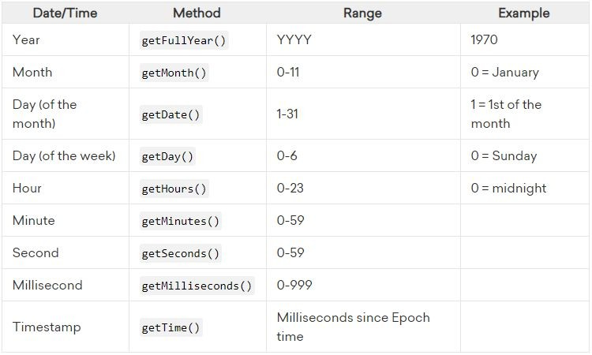

Slide 240
Retrieving the Date Components
var date = new Date("June 14 2019 10:45:25");
date.getMinutes(); date.getSeconds();
// 45
// 25
date.getFullYear();// 2019
date.getMonth(); // 5
date.getDate(); // 14
date.getDay(); // 5
date.getHours(); // 10
date.getMilliseconds();//0 date.getTime();
//1560491125000

Slide 241
Modifying the Date
For all the get methods that we learned, there is a corresponding set method.
Where get is used to retrieve a speciﬁc component from a date, set is used to modify components of a date

Slide 242
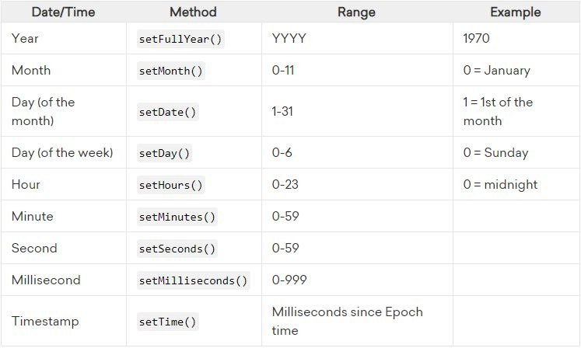

Slide 243
Modifying the Date
var date = new Date("June 14 2019 10:45:25"); console.log(date);
// Fri Jun 14 2019 10:45:25 GMT+0500 (Pakistan Standard Time)
date.setFullYear(2017); console.log(date);
// Wed Jun 14 2017 10:45:25 GMT+0500 (Pakistan Standard Time)

Slide 244
Converting Day of Week to Text
getDay() function returns day of week, but it will give number representing day from 0 to 6
0 represent Sunday, 1 represent Monday and so on
If you want on convert this value into text representation then you have to do it yourself
You create array represent day of week in text format and then map value from getDay() function to array

Slide 245
Converting Day of Week to Text
var daysList = ["Sun", "Mon", "Tue", "Wed",
"Thu", "Fri", "Sat"];
var date = new Date("June 14 2019 10:45:25"); var day = date.getDay(); // 5
var nameOfDay = daysList[day]; // Fri

Slide 246
Calculate Time difference
You can calculate time difference between two days using getTime and calculate difference in days
getTime returns time in milliseconds so you can ﬁnd out time difference in milliseconds by subtracting dates
Then need ﬁnd out of milliseconds in a day
24 hours * 60 minutes * 60 seconds * 1000 milliseconds
And divide time difference in milliseconds with milliseconds of a day

Slide 247
Calculate Time difference
var | d1 | = | new | Date("June | 14 | 2019 |  | 10:45:25");
var | d2 | = | new | Date("June | 28 | 2019 |  | 10:45:25");
var var | timeDiff = d2.getTime() days = timeDiff / (1000 |  |  |  |  | - * | d1.getTime(); 60 * 60 * 24);// |  | 14

Slide 248
Functions

Slide 249
Functions
A function is a block of JavaScript that does the same thing again and again.
A JavaScript function is executed when "something" invokes it (calls it).
It saves you repetitive coding and makes your code easier to understand.
You can reuse code: Deﬁne the code once, and use it many times

Slide 250
Function Declarations
A JavaScript function is deﬁned with the function keyword, followed by a name, followed by parentheses ().
Function names can contain letters, digits, underscores, and dollar signs (same rules as variables).
The parentheses may include parameter names separated by commas: (parameter1, parameter2, ...)
The code to be executed, by the function, is placed inside curly brackets: {}

Slide 251
Function Declarations
function name(parameter1, parameter2) {
// code to be executed
}

Slide 252
Function Declarations
function sum(a, b){ return a + b;
}
Declared functions are not executed immediately. They are "saved for later use", and will be executed later, when they are invoked (called upon).

Slide 253
Invoking a Function
Functions execute when the function is called.
This process is known as invocation.
You can invoke a function by referencing the function name, followed by an open and closed parenthesis: ().

Slide 254
Invoking a Function
Declarations
function showMessage(message){ console.log(message);
}
Invoking
showMessage("Hello World");

Slide 255
Parameters vs. Arguments
Parameters:
Function parameters are listed inside the parentheses () in the function deﬁnition.
Arguments:
Function arguments are the values received by the function when it is invoked.

Slide 256
Parameters vs. Arguments
Declarations
function showMessage(message){ console.log(message);
}
Invoking
showMessage("Hello World");
Parameter
Argument

Slide 257
Passing Data to Function
In order for a function to become a programmable robot rather than a one-job robot, you have to set it up to receive the data you're passing.
You can pass any type of data to function depending on requirement

Slide 258
Passing Data to Function
function multiply(num1, num2){ var num3 = num1 * num2; console.log("Num3 ",num3);
}
multiply(3,6); multiply(4,2);

Slide 259
Passing Data to Function
function showMessage(name){ console.log("Hello "+name);
}
showMessage("Mike"); showMessage("John");

Slide 260
Parameter Rules
JavaScript function deﬁnitions do not specify data types for parameters.
JavaScript functions do not perform type checking on the passed arguments.
JavaScript functions do not check the number of arguments received.
If a function is called with missing arguments (less than declared), the missing values are set to: undeﬁned

Slide 261
Parameter Rules
function showMessage(name){ console.log("Hello "+name);
}
showMessage("John"); showMessage(45); showMessage(true); showMessage();
// Hello John
// Hello 45
// Hello true
// Hello undefined
showMessage("Mike", 12);// Hello Mike

Slide 262
Function Return
Function can returns data back to caller
After executing logic in function if you want to return result to the caller of function then you use return keyword
When JavaScript reaches a return statement, the function will stop executing and return value is "returned" back to the "caller"
Every function in JavaScript returns undeﬁned unless otherwise speciﬁed

Slide 263
Function Return
function test(){
}
var a = test(); // return undefined console.log(a); // undefined

Slide 264
Function Return
In this example we explicitly tell the function to return 45
function test(){ return 45;
}
var a = test(); | // | return 45
console.log(a); | // | 45

Slide 265
Function Return
function multiply(num1, return num1 * num2; | num2){
}
var a = multiply(3,6); | // | returns | 18
var b = multiply(4,2); | // | returns | 8
console.log(a); | // | 18
console.log(b); | // | 8
console.log(multiply(2,5)); // 10

Slide 266
Function Return
function multiply(num1, num2){
return num2; // function execution ends here return num1 * num2;
}
var a = multiply(3,6); console.log(a);
// returns 6
// 6

Slide 267
Function in Expressions
JavaScript functions can be used in expressions
Just like we use variables in calculation we can use function and output function will be included in calculation
function multiply(num1, num2){ return num1 * num2;
}
var a = multiply(3,4) + 5

Slide 268
Function in Expressions
function multiply(num1, num2){ return num1 * num2;
}
function sum(a, b){
// Result of multiply sum with value of b return multiply(a,b) + b; //16
}
var total = sum(3,4) + 6; // result 22

Slide 269
Function in Expressions
function multiply(num1, num2){ return num1 * num2;
}
function sum(a, b){ return a + b;
}
// Call multiply first and result passed to sum var total = sum(multiply(3,4), 2) + 6; // result 20

Slide 270
Local vs Global Variables
Variables can have local or global scope
A global variable is one that's declared in the main body of your code, not inside a function.
A local variable is one that's declared inside a function.
A local variable can be either a parameter of the function, which is declared implicitly by being named as a parameter, or a variable declared explicitly in the function with the var keyword.

Slide 271
Local vs Global Variables
Global variable is meaningful in every section of your code, whether that code is in the main body or in any of the functions.
Local variable is one that's meaningful only within the function that declares it.

Slide 272
Local vs Global Variables
7. there are two differences between global and local variables—where they're declared, and where they're known and can be used.
Global Variables | Local Variables
Declared in the main code | Declared in a function
Known everywhere, useable everywhere | Known only inside the function, usable only inside the function

Slide 273
Local vs Global Variables
var a = 7; function sum(){
var b = 6;
var c = a + b;
// Global Variable
// Local Variable
// 13, Accessing global
console.log("C "+c);
}
sum();
console.log("A = "+a); // 7

Slide 274
Local vs Global Variables
var a = 7; function sum(){
// Global Variable
var b = 6; | // | Local Variable
a = b + 5;
console.log("A | "+a);// | Accessing global | variable
}
sum();
console.log("A = "+a);
// 11, value of a updated

Slide 275
Local vs Global Variables
var a = 7; function sum(){
var b = 6; a = b + 5;
}
sum();
console.log("B = "+b);
// Global Variable
// Local Variable
// error, b is not available outside sum function

Slide 276
Local vs Global Variables
var a = 7; function sum(){
var a = 6; a = 3 + 2;
// Global Variable
// Local Variable a same name as global
// Local a variable will be affected
console.log("A "+a);//5, access local variable
}
sum();
console.log("A "+a);//7, access global variable

Slide 277
Global Variables without var keyword
If you create variable without var keyword it will be global variable not matter where you have created it
Variable created without var inside function it be global variable
Variable created without var in main body/code will be global variable
It is recommended to use variable with var keyword to have deﬁned context

Slide 278
Global Variables without var keyword
a = 7;
// Without var still Global Variable
function var b | sum(){ = 6; | // | Local Variable
a = b | + 5;
console.log("A "+a);// Accessing global variable
}
sum(); console.log("A "+a);
// 11, value of a updated

Slide 279
Global Variables without var keyword
a = 7; // Without var still Global Variable function sum(){
b = 6; // Global variable because its without var a = b + 5;
console.log("A "+a);// Accessing global variable
}
sum();
console.log("B "+b);//b available outside of function

Slide 280
Function Expressions
A JavaScript function can also be deﬁned using an expression.
A function expression can be stored in a variable
var sum = function (a, b){ return a + b;
};
var c = sum(4,5); console.log(c);
// function as expression

Slide 281
Function Expressions
After a function expression has been stored in a variable, the variable can be used as a function
The function in expression is actually an anonymous function (a function without a name).
Functions stored in variables do not need function names. They are always invoked (called) using the variable name.

Slide 282
Function Expressions
var square = function(num) { return num * num; }; var b = square(4); // 16
Notice that function above ends with semicolon because it is part of executable statement

Slide 283
Function Hoisting
Hoisting is JavaScript's default behavior of moving declarations to the top of the current scope.
Hoisting applies to variable declarations and to function declarations.
Because of this, JavaScript functions can be called before they are declared

Slide 284
Function Hoisting
var total = sum(5,6); //Calling before declaration console.log("Sum = "+total);
function sum(a, b){ return a + b;
}

Slide 285
Arguments Passed by Value
Primitive data is passed by value: The function only gets to know the values, not the argument's locations.
If a function changes an argument's value, it does not change the parameter's original value.
Changes to arguments are not visible (reﬂected) outside the function.

Slide 286
Arguments Passed by Value
var num = 5;
function changeValue(a){
a = 7; // change to a will not affect num
}
changeValue(num);
console.log(num);//5, num will be be updated

Slide 287
Arguments Passed by Reference
In JavaScript, object references are values.
Non-primitive value such as Array or a user-deﬁned object are passed by reference
If function changes the object's properties, that change is visible outside the function

Slide 288
Arguments Passed by Reference
var arr = [4, 6, 7, 9];
function updateArray(val){ // array received in val val[1] = 57; // updating val will also update arr
}
console.log(arr[1]); updateArray(arr); console.log(arr[1]);
// 6 before calling function
// 57 after calling function

Slide 289
Arguments Passed by Reference
var obj = { name: "John", age:56 };
function updateObject(val){ // object received in val val.age = 40; // updating val will also update arr
}
console.log(obj.age); updateObject(obj); console.log(obj.age);
// 56 before calling function
// 40 after calling function

Slide 290
Recursive Function
A recursive function is a function that calls itself.
Recursion is a technique for iterating over an operation by having a function call itself repeatedly until it arrives at a result.
In some ways, recursion is analogous to a loop. Both execute the same code multiple times, and both require a condition (to avoid an inﬁnite loop, or rather, inﬁnite recursion in this case)

Slide 291
Recursive Function
The classic example of a function where recursion can be applied is the factorial.
Factorial of a number n can be deﬁned as product of all positive numbers less than or equal to n.
It is the multiplying sequence of numbers in a descending order till 1. It is deﬁned by the symbol of exclamation (!).
E.g factorial of 6 is
a. 6 × 5 × 4 × 3 × 2 × 1 = 720

Slide 292
Recursive Function
function factorial(n) { if (n <= 1) {
// Recursion will stop when this condition match return 1;
} else {
return n * factorial(n - 1); // calling itself
}
}

Slide 293
Switch Statement
The switch statement executes a block of code depending on different cases.
The switch statement is a part of JavaScript's "Conditional" Statements, which are used to perform different actions based on different conditions.
Switch statement works for equality checks only, you can not apply range, greater than or less then checks

Slide 294
Switch Statement
This is how it works:
The switch statement evaluates an expression.
The value of the expression is then compared with the values of each case in the structure.
If there is a match, the associated block of code is executed.
The switch has one or more case blocks and an optional default.

Slide 295
Switch Syntax
switch(expression) {
case 'value1': // same as if (expression === 'value1')
// code block break;
case 'value2':
// code block break;
default:
// code block
}

Slide 296
Switch Statement
var day = 3; switch (day) {
case 6:
console.log("Today is Saturday"); break;
case 0:
console.log("Today is Sunday"); break;
default:
console.log("Looking forward to the Weekend");
}

Slide 297
Switch - Grouping of case
Sometimes you will want different cases to use the same code, or fall-through to a common default.
If you skip the break and expression match to the case where there is no break then it will also fall-through the next case

Slide 298
Switch - Grouping of case
var day = 3; switch (day) {
case 6: // No break console.log("Today is Saturday");
case 0: // No break in last case, both will execute console.log("Today is Sunday");
break; default:
console.log("Looking forward to the Weekend");
}

Slide 299
Switch - Grouping of case
var day = 3; switch (day) {
case 6:
case 0:
console.log("Yaaaa! It’s Weekend"); break;
default:
console.log("Looking forward to the Weekend");
}

Slide 300
Switch - Strict Comparison
Switch cases use strict comparison (===).
The values must be of the same type to match.
A strict comparison can only be true if the operands are of the same type.

Slide 301
Switch - Strict Comparison
var x = "0"; switch (x) {
case 0:
console.log("Off"); break;
case 1:
console.log("On"); break;
default: // this will execute as value did not match console.log("No value found");
}

Slide 302
While loop
1. The while loop loops through a block of code as long as a speciﬁed condition is true.
Syntax:
while (condition) {
// code block to be executed
}

Slide 303
While loop
In this example, the code in the loop will run, over and over again, as long as a variable (i) is less than 10:
while (i < 10) { console.log("I " + i); i++;
}
You will use while loop when execution is dependent on user input

Slide 304
Do/While loop
The do/while loop is a variant of the while loop. This loop will execute the code block once, before checking if the condition is true, then it will repeat the loop as long as the condition is true.
You will use do/while loop when execution is dependent on user input but it needs to run code block at least once

Slide 305
Do/While loop
Syntax:
do {
// code block to be executed
}
while (condition);

Slide 306
Do/While loop
do {
console.log("I " + i); i++;
}
while (i < 10);

Slide 307
Part 2 Ends

